Slide 1
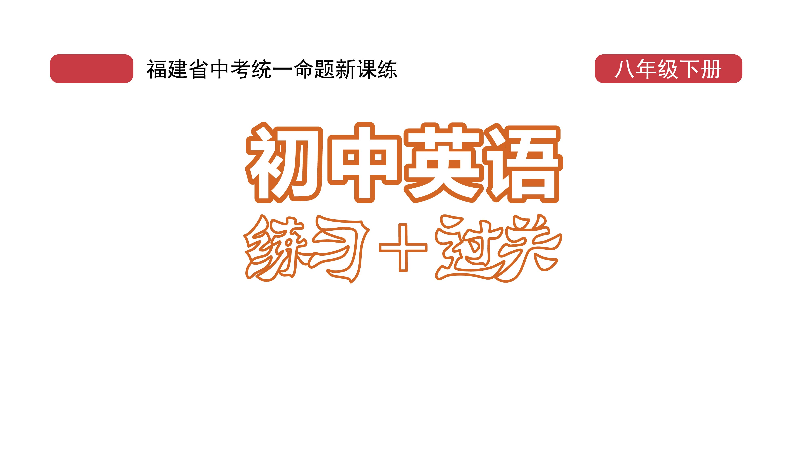
课时练习
模块八 第一章 第四节

Slide 2
一、翻译下列词组。
1. 由……制成 ________________
2. 保护……免受…… ________________
3. 不同材料 ______________________
4. 制作不同种类的衣服 _________________________
5. 保暖 ________________
6. 穿着制服 __________________
be made of …
protect … from …
different materials
make different kinds of clothes
keep warm
wear/in uniforms

Slide 3
二、用括号内所给单词的适当形式填空， 每空一词。
1. They were ___________ (discuss) the 100th birthday of the CPC(共产党).
2. You should be able to guess the _________(mean) of the word from the context(语境).
3. There’s a famous ____________ (say) that goes, “Practice makes perfect.”
discussing
meaning
saying

Slide 4
二、用括号内所给单词的适当形式填空， 每空一词。
4. I showed that I didn’t like this type of clothes by __________ (keep) quiet.
5. China successfully ________ (send) Shenzhou-12 manned spaceship into space in 2021.
keepving
sent

Slide 5
三、单项选择。
( )1. —Your scarf looks so nice. Is it made____silk?
—Yes, and it’s made______Hangzhou.
A. of; by B. from; in C. of; in
C

Slide 6
三、单项选择。
( )2. —Who is the girl ______ hanfu?
—She is Li Ziqi. And she made it by herself.
A. wears B. in C. on
B

Slide 7
三、单项选择。
( )3. Players must wear padding(防护垫) to _____ them ______ injury.
A. keep; away B. protect; from
C. help; with
B

Slide 8
三、单项选择。
( )4. —I won first place in the five-kilometer race.
—________!
A. Wish you success
B. Good luck to you
C. Congratulations
C

Slide 9
三、单项选择。
( )5.The exercises are so ______ that almost anyone can do them.
A. simple B. suitable C. smooth
A

Slide 10
四、用so, so … that, so that和such … that 填空， 每空不限词数。
1. She spoke______quietly______I couldn’t hear her.
2. There wasn’t much traffic, _________we arrive half an hour earlier.
3. He worked hard________everything would be ready in time.
so that
so that
so that

Slide 11
四、用so, so … that, so that和such … that 填空， 每空不限词数。
4. It’s_______heavy a box_______the old man can’t carry it.
5. He is_______a stubborn（固执的） person ______ it is hard to change his mind.
so that
such that

Slide 12
五、根据提示词翻译下列句子。
1. 雨伞可以保护我们在雨天免于淋雨。（protect…from…）___________________________________________________
2. 俗话说： 衣如其人。（saying, what）
___________________________________________________
3. 你知道这些围巾是由什么制成的吗？（be made of）
___________________________________________________
Umbrellas can protect us from the rain on rainy days.
As the saying goes, “You are what you wear.”
Do you know what these scarfs/scarves are made of？

Slide 13
五、根据提示词翻译下列句子。
4. Eden不如David随和。（not so … as …）___________________________________________________
5. 运动不只是让我们保持健康。（exercise， do more than）___________________________________________________
___________________________________________________
Eden isn’t so/as easy-going as David.
Exercise/Doing exercise does more than just keep us fit/healthy.

Slide 14
